Slide 1
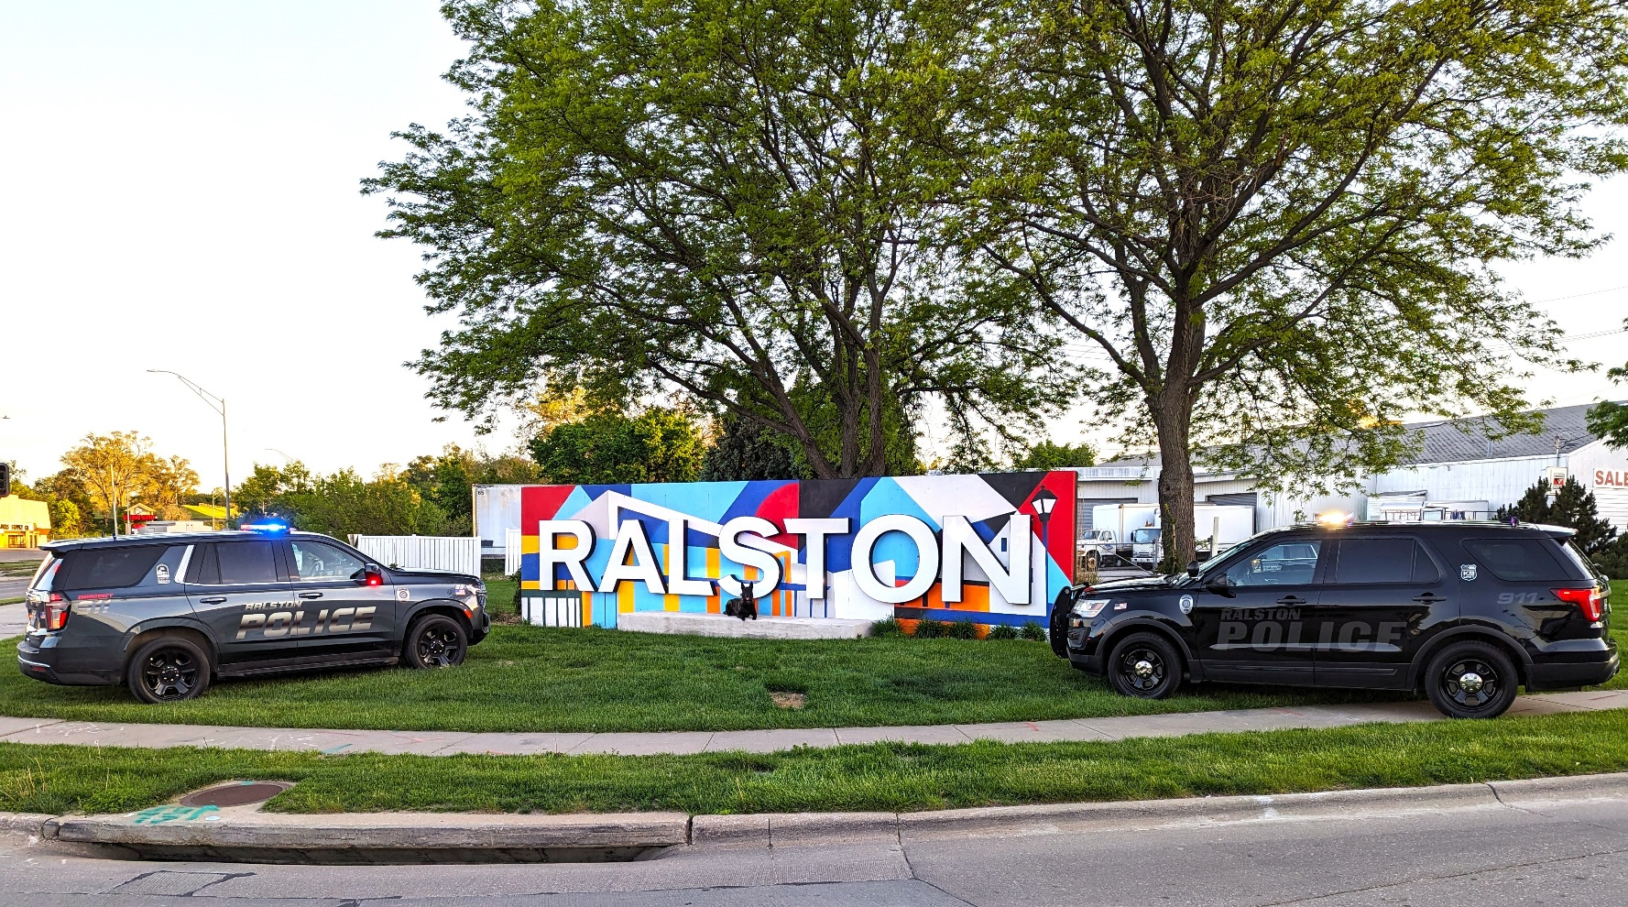
Ralston Police Department
Year End Report
2024

Slide 2
Chief of Police Comments
Dear Mayor, City Council Members and Citizens of the Community,
The year 2024 once again brought several employee changes to the Ralston Police Department. One officer decided to join the ranks of the Omaha Police Department in a February lateral class and then in August, we lost the longest tenured officer of this department, John Gross, to retirement. While it is always tough to lose someone with that much time on the department, we also lost his depth of experience in a variety of areas that is always hard to replace. Officer Gross wore many hats in the department, including but not limited to, taking care of all Body Worn Camera (BWC) videos and cruiser camera videos needing saved, purged or copied for court cases, was one of our Datamaster breath testing maintenance officers, maintained the identification system that made employee ID cards, and made sure all officers had current NCJIS certificates downloaded on their computers or cell phones. Officer Gross was our Property and Evidence Room manager who took care of all evidence submitted from cases. He maintained all records and transferred and picked up property and evidence from our partners at the Douglas County Sheriff’s Office (DCSO). Officer Gross was also an Accident Reconstructionist and was part of an interlocal team that investigated all serious accidents in Douglas and Sarpy County. Last, at one time Officer Gross was one of the longest serving Emergency Vehicle Operations Instructors until he let that pass on to others in the department.
While we are committed to filling those roles, Officer Gross left upon his departure, we also welcomed two new members to our department. Officer Jordan Monk joined our team in April 2024. He came to us from the U.NO. Police Department and the Boys Town Police Department and has just recently successfully finished his Probationary phase. Officer Ryne Fischer was hired in July 2024 and, due to a technicality from when he was with the Bellevue Police Department, he had to go through an initial phase of (32) Continuing Education (CE) hours missing from 2023 and, also another (32) hours of CE training for 2024 which kept him plenty busy. He just recently successfully finished his three and a half months of Field training and is currently in his Probationary phase with the department. With these hires, the Ralston Police Department is operating at full authorized strength which is a comfort not only to our shift scheduling but also to the citizens of Ralston.
For our department, one of my main goals is to supply our officers with the best equipment that will give them an edge to perform their jobs successfully. Technology has always been on the forefront of any successful law enforcement agency, and Ralston is no different. Whether it be looking for the best vehicles for our cruisers, or the equipment that goes in them, we are always looking for new innovative ways to improve how our department and our officers operate on a daily basis. Investigations are always the most intriguing and sometimes most difficult aspect of law enforcement but having the most current technological tools makes our jobs a bit easier. 2024 saw an influx into the purchase of numerous cameras to monitor our many parks and certain other areas of the city. Toward the end of they year, we were paid a visit by an ex-Ralston Police officer who was currently working for a large corporation in the area. This company donated two Unmanned Aerial Vehicles (UAV’s or drones) to the department. These will assist in many areas including investigations, scene management of any major incident, looking for lost children or elderly persons, or for monitoring large scale events such as the Independence Day parade celebration and the surrounding events of that holiday.
Training, as always, will be a top priority for this department. Of the state mandated continuing education hours all our officers must complete we would need a total of 448 hours tracked for the year. Although training hours for 2024 were down slightly from 2023, we still managed to log nearly 1200 of total training for the department. We all participate in the mandated topics of defensive tactics, firearms, emergency vehicle operations and pursuit policy review, anti-bias and implicit bias, officer wellness, substance abuse, de-escalation, child abuse, legal updates and domestic violence. Our department also trains in other topics, such as behavioral health response, diversity training, interview and interrogations, excited delirium, Ethics, and a variety of others. We have a well rounded and excellently trained group of officers that serve this City.

Slide 3
Things are already looking promising for 2025. Our department will continue to serve and protect this community with integrity, honor, pride and professionalism. Should you have any questions about this report, feel free to contact me.
Respectfully,
Marc A. Leonardo
Chief of Police

Slide 4
Officer John Gross retires after 35 years with the Ralston Police Department

Slide 5
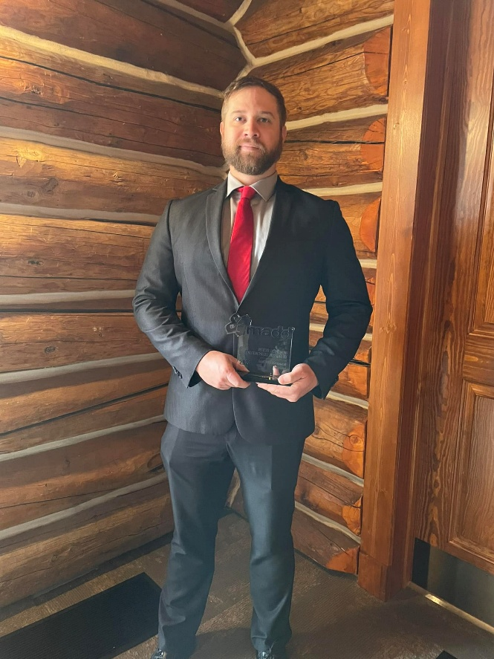
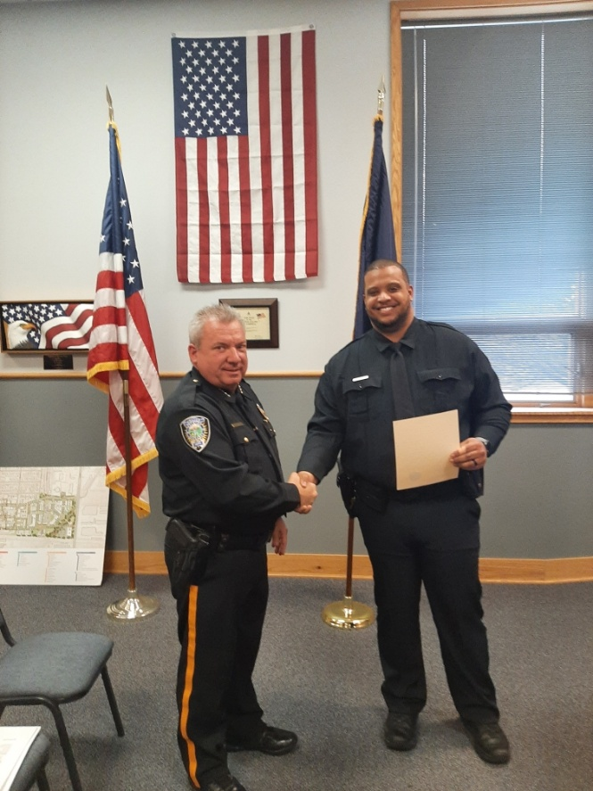
Officer Grob receives the MADD Award for his work on DUI enforcement.
Officer Monk joins the department.

Slide 6
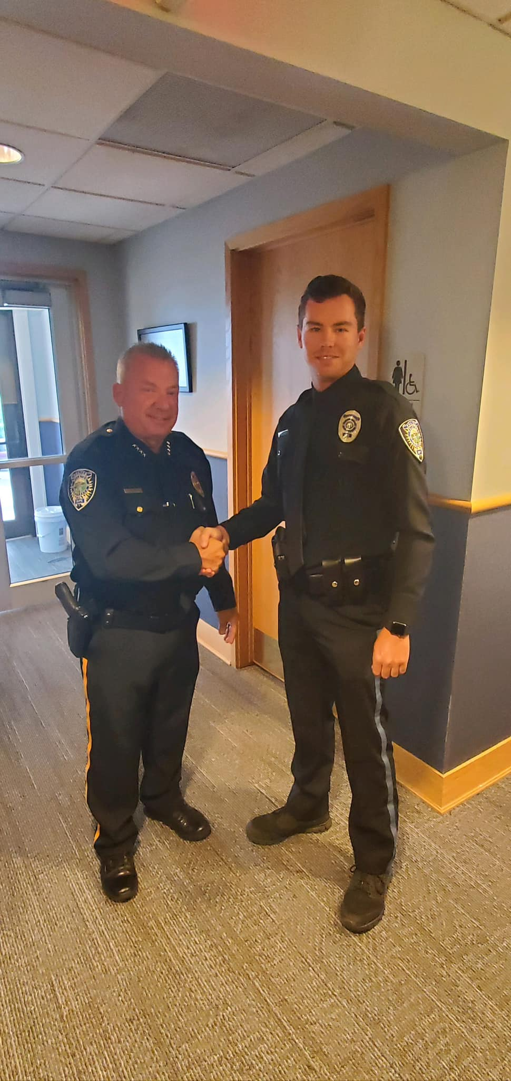
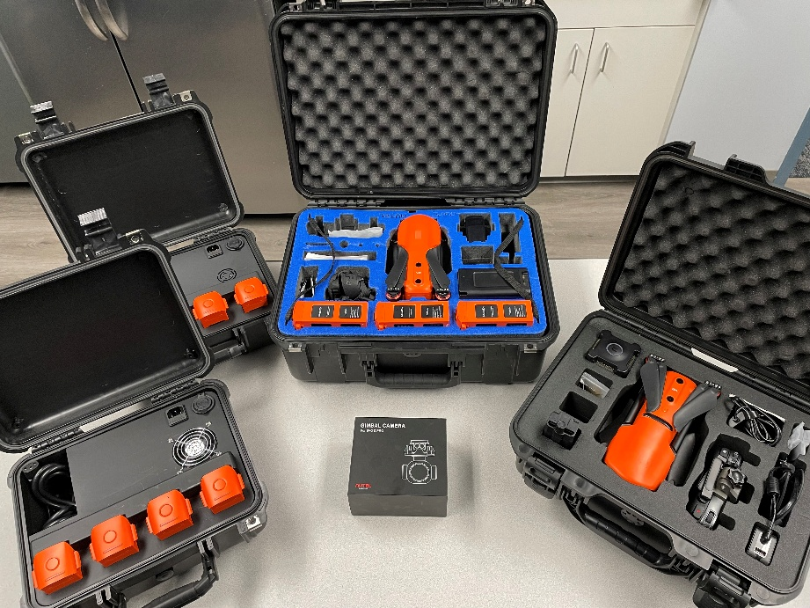
Officer Fischer is sworn in as the newest member of RPD
Valmont donates two UAS units to the police department

Slide 7
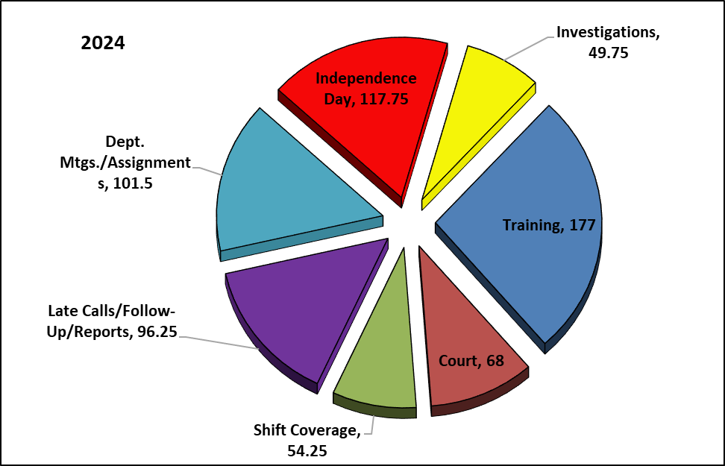
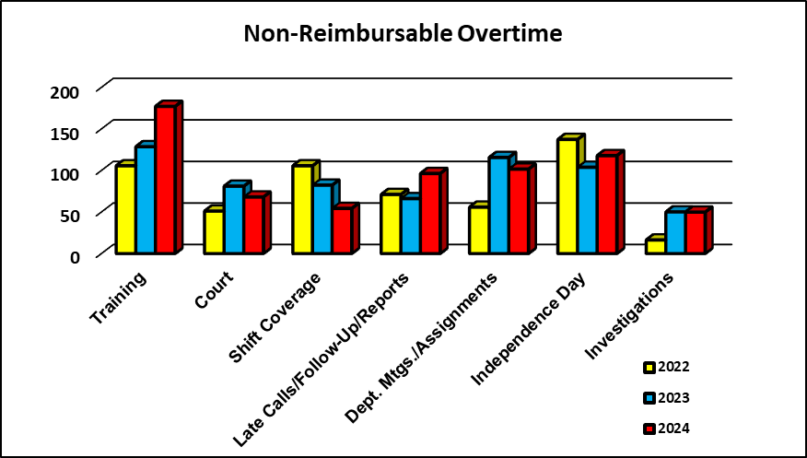
Non-Reimbursable Overtime
The department had an increase in overtime expenditures in 2024. Overtime increased from 627 hours in 2023 to 664 hours in 2023, a 5.9% increase. Overtime for training (+37.7%), late calls and follow up (+45.8%), and Independence Day (+13.5%) increased from 2023. Even though the department was short staffed for large portions of the year, shift staffing was achieved by moving personnel to cover shifts. This allowed for less overtime hours for shift coverage. This led to a 34% decrease in overtime for shift coverage in 2024. Other categories in overtime that saw decreases from 2023 were court (-16%), department assignments and meetings (-12%), and investigations (-.5%).

Slide 8
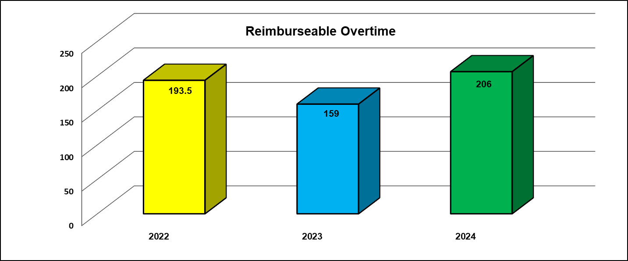
Reimbursable Overtime
Every year the Nebraska Office of Highway Safety has several grants available to pay for agencies to participate in traffic enforcement initiatives. These grant funds paid 100% of
overtime wages for officers who participated in these initiatives. In 2024 RPD participated in the U Text, U Drive, U Pay campaign, the Drug Impaired Driving campaign, two Make It Click seat belt initiatives, two Drive Sober or Get Pulled Over operations, and a speeding enforcement campaign. During these events, additional officers worked saturation patrols, focusing on traffic related offenses to ensure seat belt compliance, remove drivers impaired by alcohol and/or drugs from the streets, and locate drivers distracted by mobile devices and speeders. Some of these grants took place around holidays when there are more people traveling. Project Extra Mile also provided funds for officers to work with the Douglas County DUI Task Force to take impaired drivers off the road. They also provided funds for officers to take part in county wide compliance checks to ensure businesses are not selling alcohol to minors. Due to more officers participating in these grants in 2024, reimbursable overtime hours increased from 159 hours in 2023 to 206 hours in 2024, an increase of nearly 30%.

Slide 9
Grants
Grants are always important for the department, and 2024 was no different. Three officers needed new ballistic vests last year. Vest manufacturers recommend vests are replaced every five years. The U.S. Department of Justice provided a grant for $1,807.49 to assist the department in purchasing vests for these officers. The DOJ sponsors a Bulletproof Vest Partnership with local law enforcement agencies, providing 50% match funding for new ballistic vests. As mentioned on the previous page, the Nebraska Office of Highway Safety approved grants for extra patrol for the traffic enforcement campaigns listed on the previous page. In all the state paid $10,488.52 for officers to work extra hours during these campaigns. RPD also received funds from the state to cover costs of two new cruiser camera systems to replace old systems that were at end of life. In 2024, RPD received $7,000.00 from the state to pay for these camera systems.

Slide 10
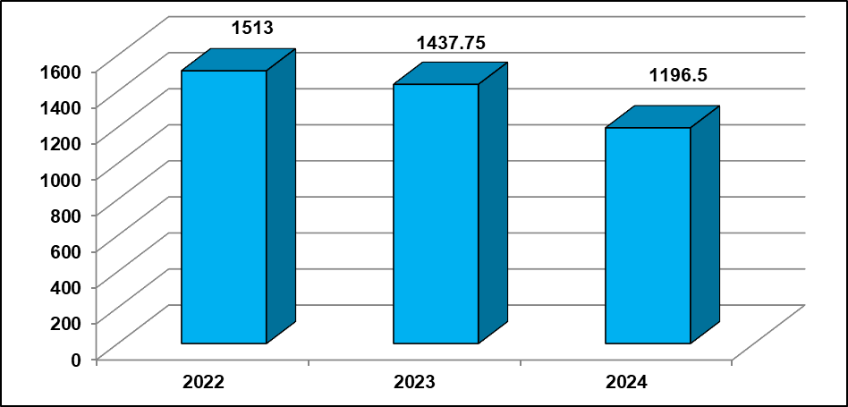
Training
The Ralston Police Department is proud to provide our officers the most up-to-date and relevant training available to allow them to do their jobs most effectively. Training allows officers to be knowledgeable on new trends and current best practices in a variety of fields which allows them to perform their duties effectively and safely. Not only does training build knowledge, but it also trains the mind and body how to respond to situations in a fraction of the time it would take without training. RPD’s training hours decreased slightly in 2024. The department hired two new officers in 2024. The new officers receive an average of 40 hours of introductory training before going to their Field Training Officers (FTO). They are then assigned to three different FTO’s for the next three months. When the FTO has the new officer with them, they are unable to attend outside training to ensure the new officer is receiving consistent evaluations during his or her training. This is one reason the training hours are down in 2024. Training topics that are mandated annually by the state include firearms, pursuit policy review, anti-bias and implicit bias, officer wellness, substance abuse, de-escalation, and legal updates. Along with these state mandated training sessions, the department takes pride in providing officers training to enhance their abilities to perform their jobs, as well as advance their careers. In 2024 officers received training in a wide variety of categories that will help in their service to the citizens of Ralston. Every year RPD officers receive training in Fair and Impartial Policing. This curriculum teaches officers about implicit bias, how implicit biases can affect decision making, and how to overcome these biases. It also teaches about the effects of police interactions on police legitimacy. RPD officers received training above and beyond what is required by the state but gives our officers the tools and knowledge to perform at a high level. The average number of training hours per officer in 2024 was 84.2, well above the 32 hours of continuing education that is required by the state.

Slide 11
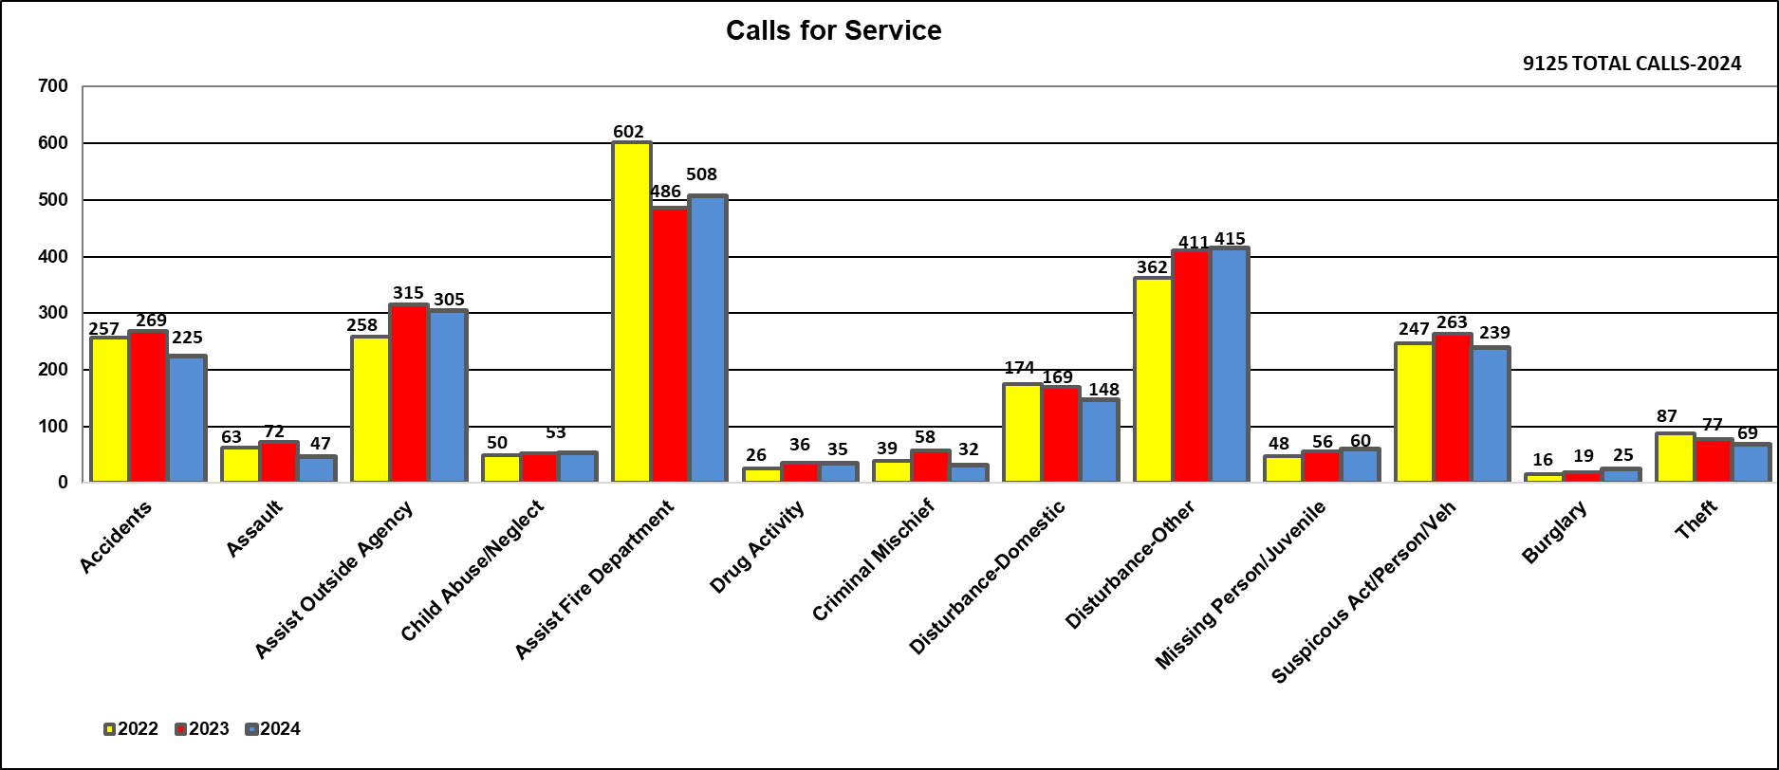
Calls For Service
Calls for service include everything our officers do on a daily basis, excluding traffic stops. In 2024 Ralston officers responded to 9,125 calls for service, which is 2.3% fewer than 2023. Every time an officer responds to a call, makes contact with a citizen, checks a business, writes red tags, blue tags, parking tickets, does school patrols, or conducts any type of special attention, it is considered a call for service and automatically generates a case file number in our report management system. The graph below illustrates thirteen major categories of the 109 categories of calls tracked this year. The following page will break down other miscellaneous categories that are still considered calls for service. Although some numbers remained similar to previous years, some increases and decreases stand out. Calls for Assaults (-34.7%), Accidents (-16.4%), Drug Activity (-2.7%), Criminal Mischief (-44.8%), Domestic Disturbance (-12.4%), Suspicious Activity/Person/Vehicle (-9%), and Theft (-10.3%) all decreased from 2023. RPD saw more calls for Assist Fire (+4.5%), Non-Domestic Disturbance (+1%), Missing Person/Juvenile (+7%) and Burglary (+31.5%) in 2024 than in 2023.

Slide 12
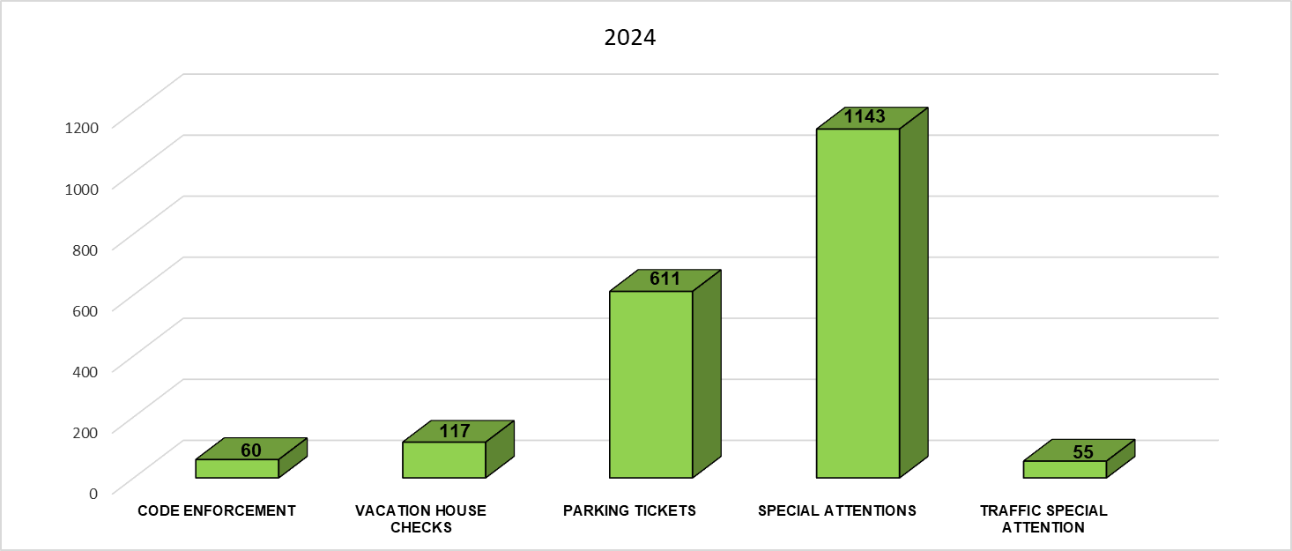
Miscellaneous Activity
Of the 9,125 calls for service our officers handled in 2024, five are listed below as miscellaneous activity. These are broken down separately due to their significance to keeping the City of Ralston a safe place to live. Special attentions can be anything from watching an open or closed business for suspicious activity, to conducting traffic enforcement on streets or intersections that have received complaints, to driving neighborhoods at night looking for unusual activity or open doors on cars or garages, or patrolling any of our local schools for traffic, pedestrian or criminal activity. These activities are all vitally important to ensure the safety of our city. RPD officers conducted 1,143 special attentions in 2024. Enforcing code violations increases the public’s positive perception of the image and livability of the City. The department handled 60 code enforcement cases in 2024, down from 73 the previous year. Vacation house checks is a service the department offers to citizens who would like us to keep watch of their homes while they are away. Officers conducted 117 vacation house checks in 2024 compared to 142 in 2023. Traffic Special Attentions happen when officers conduct extra traffic enforcement in areas known to have traffic violations or when we receive a citizen complaint of traffic offenders. RPD conducted 55 traffic special attentions in 2024, a decrease of 19% from 2023. Officers also enforce parking ordinances throughout the city. In 2024, officers wrote 611 parking citations, an increase of over 31% from 2023.

Slide 13
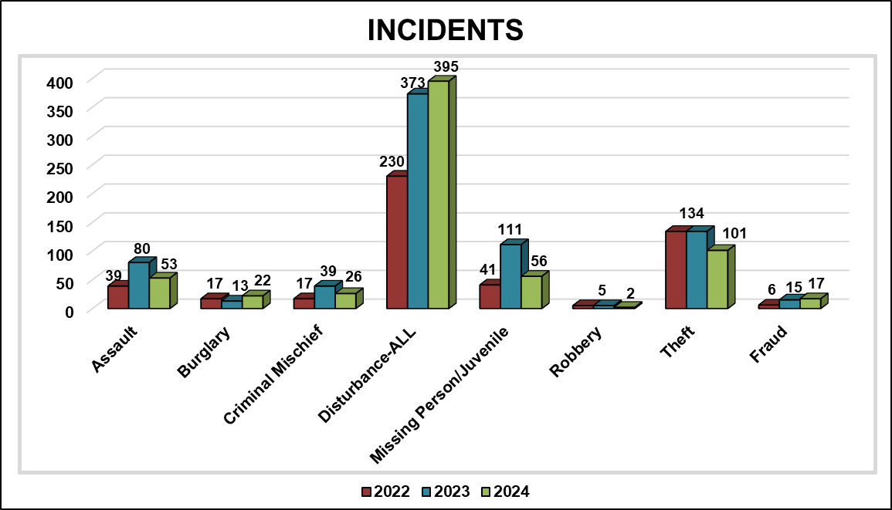
Incidents
An incident is a situation where a police report was completed with a case number assigned to it. Not all types of incidents are reflected on the graph below. However, it does reflect the most common reports taken. The Ralston Police Department generated 8,007 “case folders” in our records management system which in turn resulted in 3,628 documented police reports, a 5% increase from 2023. Sometimes officers are dispatched to a call and later learn through their investigation that a different or additional crime occurred. Sometimes people want to file a police report to document an incident; however, they do not wish to pursue criminal charges or initiate a criminal investigation. These are the types of situations which are categorized as an Incident. We saw increases and decreases across categories of incidents in 2024. Reports for burglary (+69%), disturbance (+5.8%), and fraud (+13.3%) all increased from 2023. Reports for assault (-33.7%), criminal mischief (-33.3%), missing person/juvenile (-49.5%), robbery (-60%), and theft (-24.6%) decreased in 2024.

Slide 14
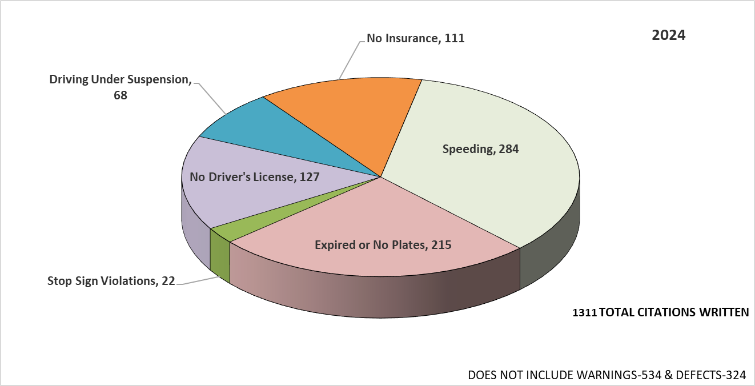
Citations
Ralston officers conducted 1,685 traffic stops in 2024, an increase of 3% from 2023. These stops resulted in a 2% increase in citations written in 2024 with a total of 1,311 citations issued. Not all traffic violations are displayed on the graph, but some of the major violations are listed. RPD saw increased numbers of citations in some of these categories. Two categories listed in the graph showed notable increases. Citations for expired or no registration (+15.5%) and no insurance (+32%) increased from 2023. As usual, other violation categories saw less citations issued. These included speeding (-15.5%), stop sign violation (-15.4%), no driver’s license (-1.5%), and driving under suspension (-19%). Not all traffic stops result in traffic citations being issued. Officers realize that educating a violator can be very effective in changing driving behavior. In these situations, written and verbal warnings are used to inform drivers of their errors and help provide them with an opportunity to correct the issue without a fine being associated with it. RPD officers issued 534 written warnings in 2024. Additionally, some stops are the result of some kind of vehicle defect. In these situations, defect violations are issued to the drivers to ensure the defect is corrected. In 2024, officers issued 324 defect violations.

Slide 15
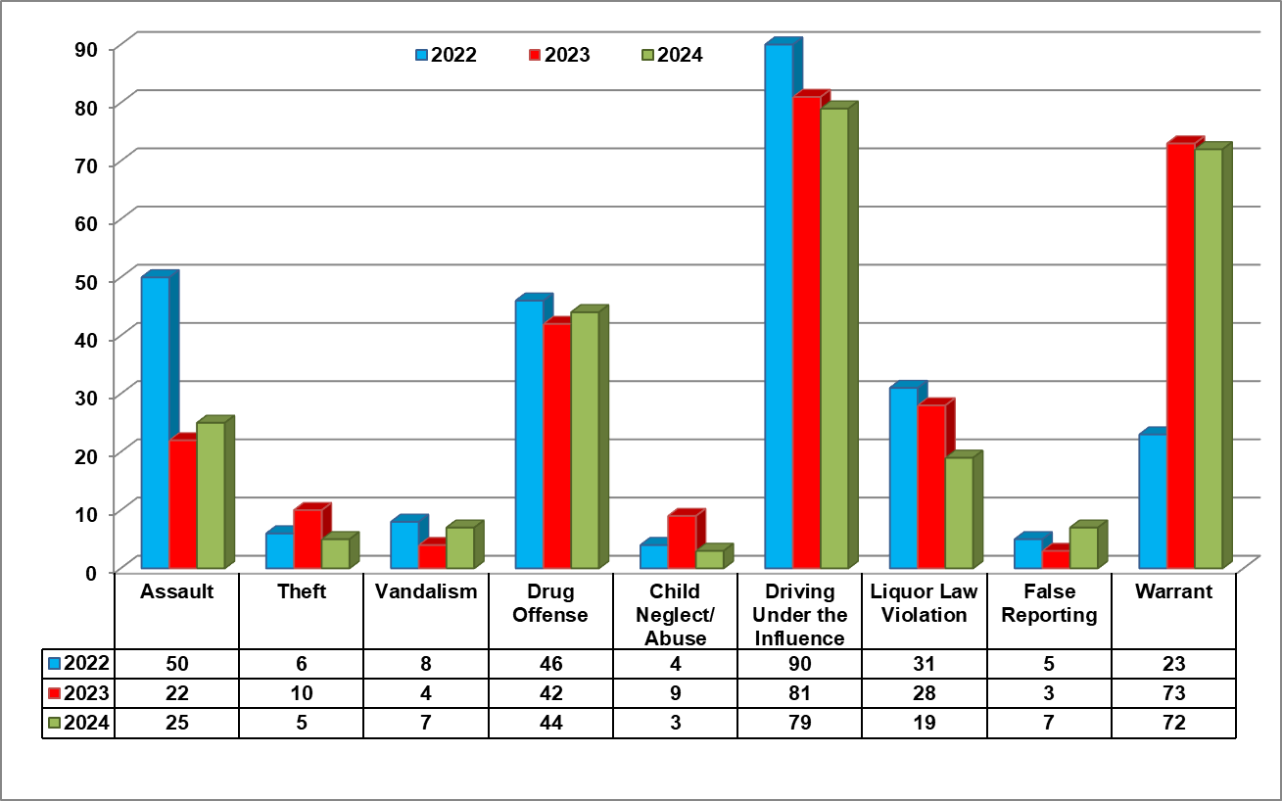
Arrests
Each year we see the number of arrests in each of the categories listed ebb and flow depending on crimes being committed in the city. 2024 was no different. Lower arrest numbers can be attributed to a lack of cooperation by a victim, insufficient evidence to make an arrest, or the investigation reveals no criminal offense occurred therefore no arrests can be made. As in years past, 2024 saw increases in arrests for some categories and decreases in others. Arrests for assault (+13.6%), vandalism (+75%), drug offenses (+4.7%), and false reporting (+133%) were all higher in 2024 than 2023. Other categories saw a decrease in arrests in 2024. These included theft (-50%), child abuse/neglect (-66.6%), DUI (-2.4%), liquor law violations (-32%), and warrant arrests (-1.3%).

Slide 16
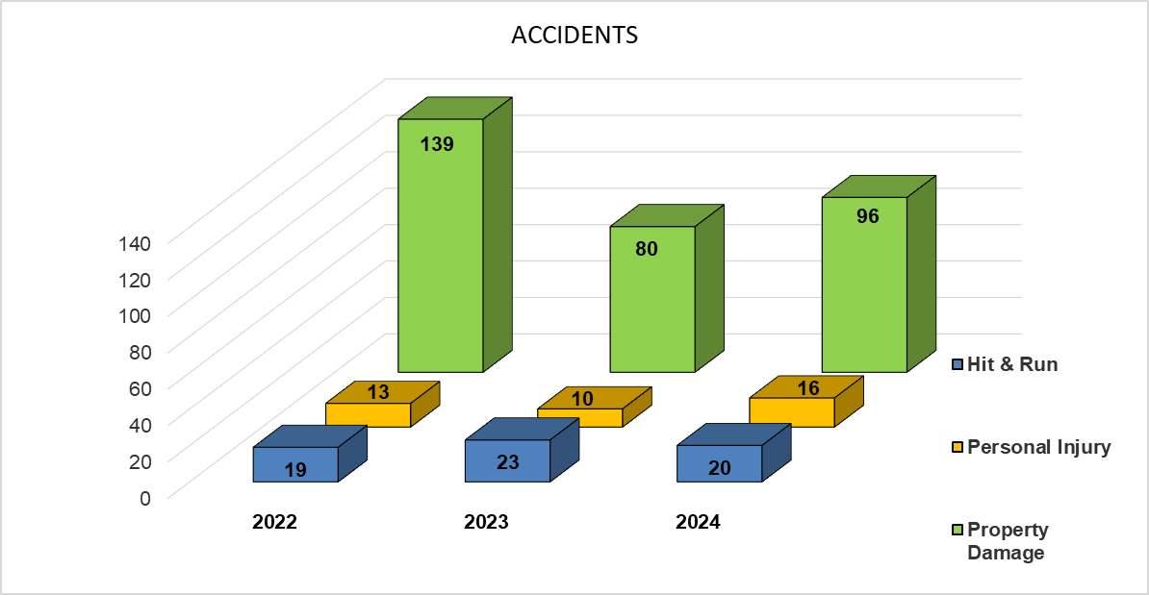
Accidents
The Ralston Police Department investigates many traffic accidents every year. These accidents are broken down into three categories: Property Damage, Personal Injury (including fatalities), and Hit and Run. Officers responded to 132 accidents in 2024, an increase of nearly 17% from 2023. Two categories, property damage and personal injury, increased in 2024. Personal injury accidents increased by 60%, and property damage accidents increased by 20%. Hit and run accidents decreased by 13% in 2024. Several of these accidents occurred throughout the city, but the vast majority occurred on or near the perimeter thoroughfares of 84th Street, 72nd Street, and Harrison Street.

Slide 17
Notable Events
January RPD opens applications for a new officer.
February The PD recognizes Officer Josh Sexton for his work as the RPD School Resource Officer on National SRO
Appreciation Day
March The Douglas County DUI Task Force runs a joint DUI operation.
April RPD takes part in the U Drive, U Text, U Pay distracted driving traffic campaign.
RPD officers take part in a region wide drug impaired driving traffic campaign.
RPD takes part in the national Prescription Drug Take Back day.
Anthony Robison is arrested on multiple felony counts for impersonating a police officer.
Officer Monk is sworn in as the newest member of the department
May National Police Week.
RPD takes part in the Make It Click traffic campaign.
Officer Grob wins a MADD award for his diligence in removing intoxicated drivers off the streets.
July Independence Day – Always RPD’s busiest day of the year.
RPD takes part in the Speeding Catches Up With You traffic campaign.
All city departments and leaders respond to a city emergency after a severe thunderstorm blows through, knocking down trees and power lines throughout the city.
August Officer Fischer is sworn in as the newest member of the department.
RPD participates in the first Drive Sober or Get Pulled Over traffic initiative of the year.
Officer John Gross retires after 35 years of service.
September Ralston officers attend the Guns & Hoses boxing event held at the Liberty First Federal Credit Union.
October Ralston participates in the Prescription Drug Take Back event.
Officers participate in three Trunk or Treat events in the city.
November RPD participated in the Make It Click traffic campaign.
Valmont Industries donates two UAS aircraft to RPD.
December RPD participated in the holiday Drive Sober or Get Pulled Over traffic initiative.

Slide 18
Training
January Sexual Assault Investigations
February Advanced Criminal Investigations
CPR Update
Human Trafficking
Background Investigations
Advanced Search and Seizure
March Criminal Interdiction
April Speaking of Children
Firearms
Recruitment for Law Enforcement
TAP Defensive Tactics Instructor
AR15 Armorer
May Emergency Vehicle Operation Training
June Property Room Management
PepperBall Instructor Recertification
SRO Training
Desert Snow Interdiction Training
July Supervision School
Policing the Teen Brain
Internet Investigations and Intelligence Gathering
FTO Training
Active Shooter Response
August Active Shooter Response
Fair and Impartial Policing
Interview and Interrogation
September Mental Health
Officer Wellness
Firearms
October Street Crimes
Interview and Interrogation
November Defensive Tactics
De-Escalation
Taser Recertification
Nebraska Legislative Updates
Arrest, Search, and Seizure
Applications of the 4th Amendment
December Managing the Property and Evidence Room
FAA Part 107 Training
Page 14

